Slide 1

(Chapter 3)
Agile Software Development
Department of Computer Science and Engineering
School of Engineering, Presidency University

Slide 2
Chapter 3 - Contents
Manifesto for Agile Software development
What is “Agility”?
Agility and the Cost of Change
Agile Process and Principles
Agile Models
  Extreme Programming (XP)
  Adaptive Software Development (ASD)
  Scrum
  Feature Driven Development
Agile Modelling
Criteria for selecting the right Process Model
Dept. of CSE, SOE, Presidency University

Slide 3
1. Manifesto for Agile S/W Development
“We are uncovering better ways of developing software by doing it and helping others do it. Through this work we have come to value:
  Individuals and interactions over processes and tools
  Working software over comprehensive documentation
  Customer collaboration over contract negotiation
  Responding to change over following a plan
That is, while there is value in the items on the right, we value the items on the left more.”
- Kent Beck et al.
Dept. of CSE, SOE, Presidency University

Slide 4
2. What is “Agility”
Effective (rapid and adaptive) response to change
Effective communication among all stakeholders
Drawing the customer onto the team
Organizing a team so that it is in control of the work performed
Yielding …
Rapid, incremental delivery of software
Dept. of CSE, SOE, Presidency University

Slide 5
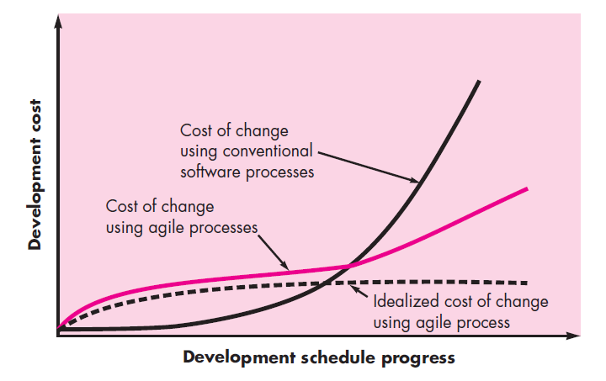
3. Agility and the Cost of Change
Dept. of CSE, SOE, Presidency University

Slide 6
4. An Agile Process
Is driven by customer descriptions of what is required (scenarios)
Recognizes that plans are short-lived
Develops software iteratively with a heavy emphasis on construction activities
Delivers multiple ‘software increments’
Adapts as changes occur
Dept. of CSE, SOE, Presidency University

Slide 7
Agile Principles - I
1. Our highest priority is to satisfy the customer through early and continuous delivery of valuable software.
2. Welcome changing requirements, even late in development. Agile processes harness change for the customer's competitive advantage.
3. Deliver working software frequently, from a couple of weeks to a couple of months, with a preference to the shorter timescale.
4. Business people and developers must work together daily throughout the project.
5. Build projects around motivated individuals. Give them the environment and support they need, and trust them to get the job done.
6. The most efficient and effective method of conveying information to and within a development team is face–to–face conversation.
Dept. of CSE, SOE, Presidency University

Slide 8
Agile Principles - II
7. Working software is the primary measure of progress.
8. Agile processes promote sustainable development. The sponsors, developers, and users should be able to maintain a constant pace indefinitely.
9. Continuous attention to technical excellence and good design enhances agility.
10. Simplicity – the art of maximizing the amount of work not done – is essential.
11. The best architectures, requirements, and designs emerge from self–organizing teams.
12. At regular intervals, the team reflects on how to become more effective, then tunes and adjusts its behavior accordingly.
Dept. of CSE, SOE, Presidency University

Slide 9
Human Factors
The process molds to the needs of the people and team, not the other way around
Key traits must exist among the people on an agile team and the team itself:
  Competence.
  Common focus.
  Collaboration.
  Decision-making ability.
  Fuzzy problem-solving ability.
  Mutual trust and respect.
  Self-organization.
Dept. of CSE, SOE, Presidency University

Slide 10
5. AGILE MODELS
5.1 Extreme Programming
The most widely used agile process, originally proposed by Kent Beck
XP Planning
  Begins with the creation of “user stories”
  Agile team assesses each story and assigns a cost
  Stories are grouped to form a deliverable increment
  A commitment is made on delivery date
  After the first increment “project velocity” is used to help define subsequent delivery dates for other increments
Dept. of CSE, SOE, Presidency University

Slide 11
Extreme Programming
XP Design
  Follows the KISS principle
  Encourage the use of CRC cards
  For difficult design problems, suggests the creation of “spike solutions” - a design prototype
  Encourages “refactoring” - an iterative refinement of the internal program design
XP Coding
  Recommends the construction of a unit test for a user story before coding commences
  Encourages “pair programming”
XP Testing
  All unit tests are executed daily
  “Acceptance tests” are defined by the customer and executed to assess customer visible functionality
Dept. of CSE, SOE, Presidency University

Slide 12
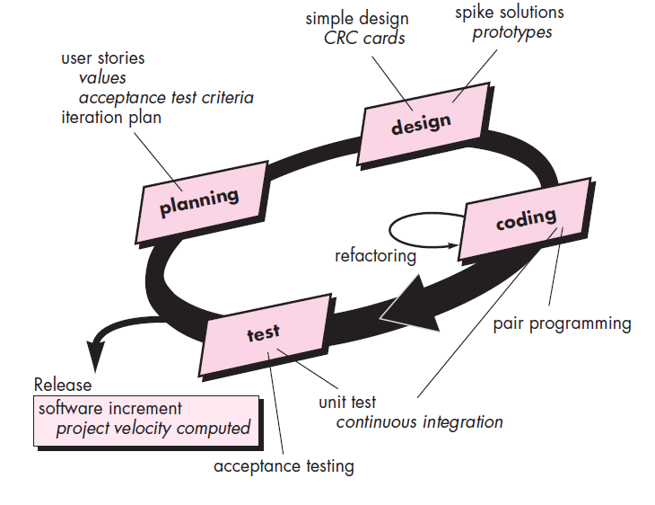
Extreme Programming Process
Dept. of CSE, SOE, Presidency University

Slide 13
5.2. Adaptive Software Development (ASD)
Originally proposed by Jim Highsmith for building complex software and systems.
Distinguishing features of ASD:
  Mission-driven planning
  Component-based focus
  Uses “time-boxing”
  Explicit consideration of risks
  Emphasizes collaboration for requirements gathering
  Emphasizes “learning” throughout the process
Dept. of CSE, SOE, Presidency University

Slide 14
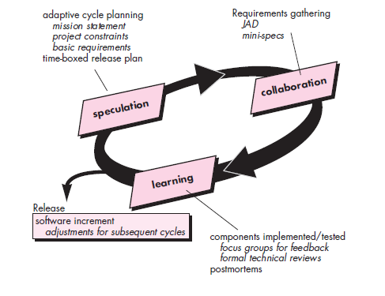
Adaptive Software Development (ASD)
Dept. of CSE, SOE, Presidency University

Slide 15
5.3. SCRUM
Originally proposed by Schwaber and Beedle
Scrum—distinguishing features
  Development work is partitioned into “packets”
  Testing and documentation are on-going as the product is constructed
  Work occurs in “sprints” and is derived from a “backlog” of existing requirements
  Items can be added to backlogs anytime, introducing changes to the system.
  Meetings are very short and sometimes conducted without chairs
  “demos” are delivered to the customer with the time-box allocated
Dept. of CSE, SOE, Presidency University

Slide 16
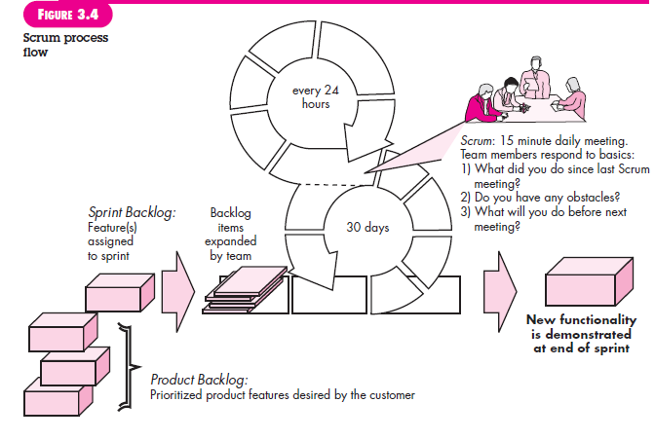
SCRUM
Dept. of CSE, SOE, Presidency University

Slide 17
5.4. Feature Driven Development
Originally proposed by Peter Coad et al
FDD - distinguishing features
  Emphasis is on defining “features”
    a feature “is a client-valued function that can be implemented in two weeks or less.”
    Feature is a small block of deliverable functionality
  Uses a feature template
    <action> the <result> <by | for | of | to> a(n) <object>
Dept. of CSE, SOE, Presidency University

Slide 18
5.4. Feature Driven Development
  Uses a feature template
    <action> the <result> <by | for | of | to> a(n) <object>
    Ex 1: Add the Product to shopping cart
    Ex 2: Display the technical specifications of the product
    Ex 3: Store the shipping information for the customer
  A features list is created and “plan by feature” is conducted
  Design and construction merge in FDD
Dept. of CSE, SOE, Presidency University

Slide 19
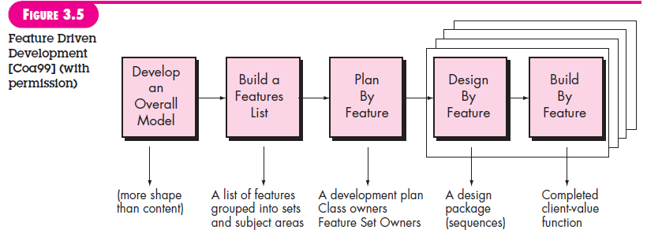
Feature Driven Development
Design walkthrough, Design, Design Inspection, Code, Code inspection
Dept. of CSE, SOE, Presidency University

Slide 20
6. Agile Modelling
Originally proposed by Scott Ambler
Is a practice-based methodology for effective modeling and documentation of software-based systems
Suggests a set of agile modeling principles
  Model with a purpose
  Use multiple models
  Travel light
  Content is more important than representation
  Know the models and the tools you use to create them
  Adapt locally
Dept. of CSE, SOE, Presidency University

Slide 21
7. Criteria for selecting the right Process Model
Factors | Waterfall | V-Shaped | Evolutionary Prototyping | Spiral | Iterative and Incremental | Agile
Unclear User Requirement | Poor | Poor | Good | Excellent | Good | Excellent
Unfamiliar Technology | Poor | Poor | Excellent | Excellent | Good | Poor
Complex System | Good | Good | Excellent | Excellent | Good | Poor
Reliable system | Good | Good | Poor | Excellent | Good | Good
Short Time Schedule | Poor | Poor | Good | Poor | Excellent | Excellent
Strong Project Management | Excellent | Excellent | Excellent | Excellent | Excellent | Excellent
Cost limitation | Poor | Poor | Poor | Poor | Excellent | Excellent
Visibility of Stakeholders | Good | Good | Excellent | Excellent | Good | Excellent
Skills limitation | Good | Good | Poor | Poor | Good | Poor
Documentation | Excellent | Excellent | Good | Good | Excellent | Poor
Component reusability | Excellent | Excellent | Poor | Poor | Excellent | Poor
Dept. of CSE, SOE, Presidency University

